Slide 1
Genre-Based Movie Recommendation System
By Ravva Yashwanth

Slide 2
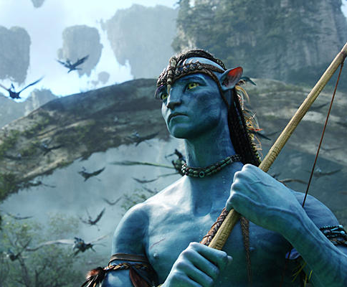

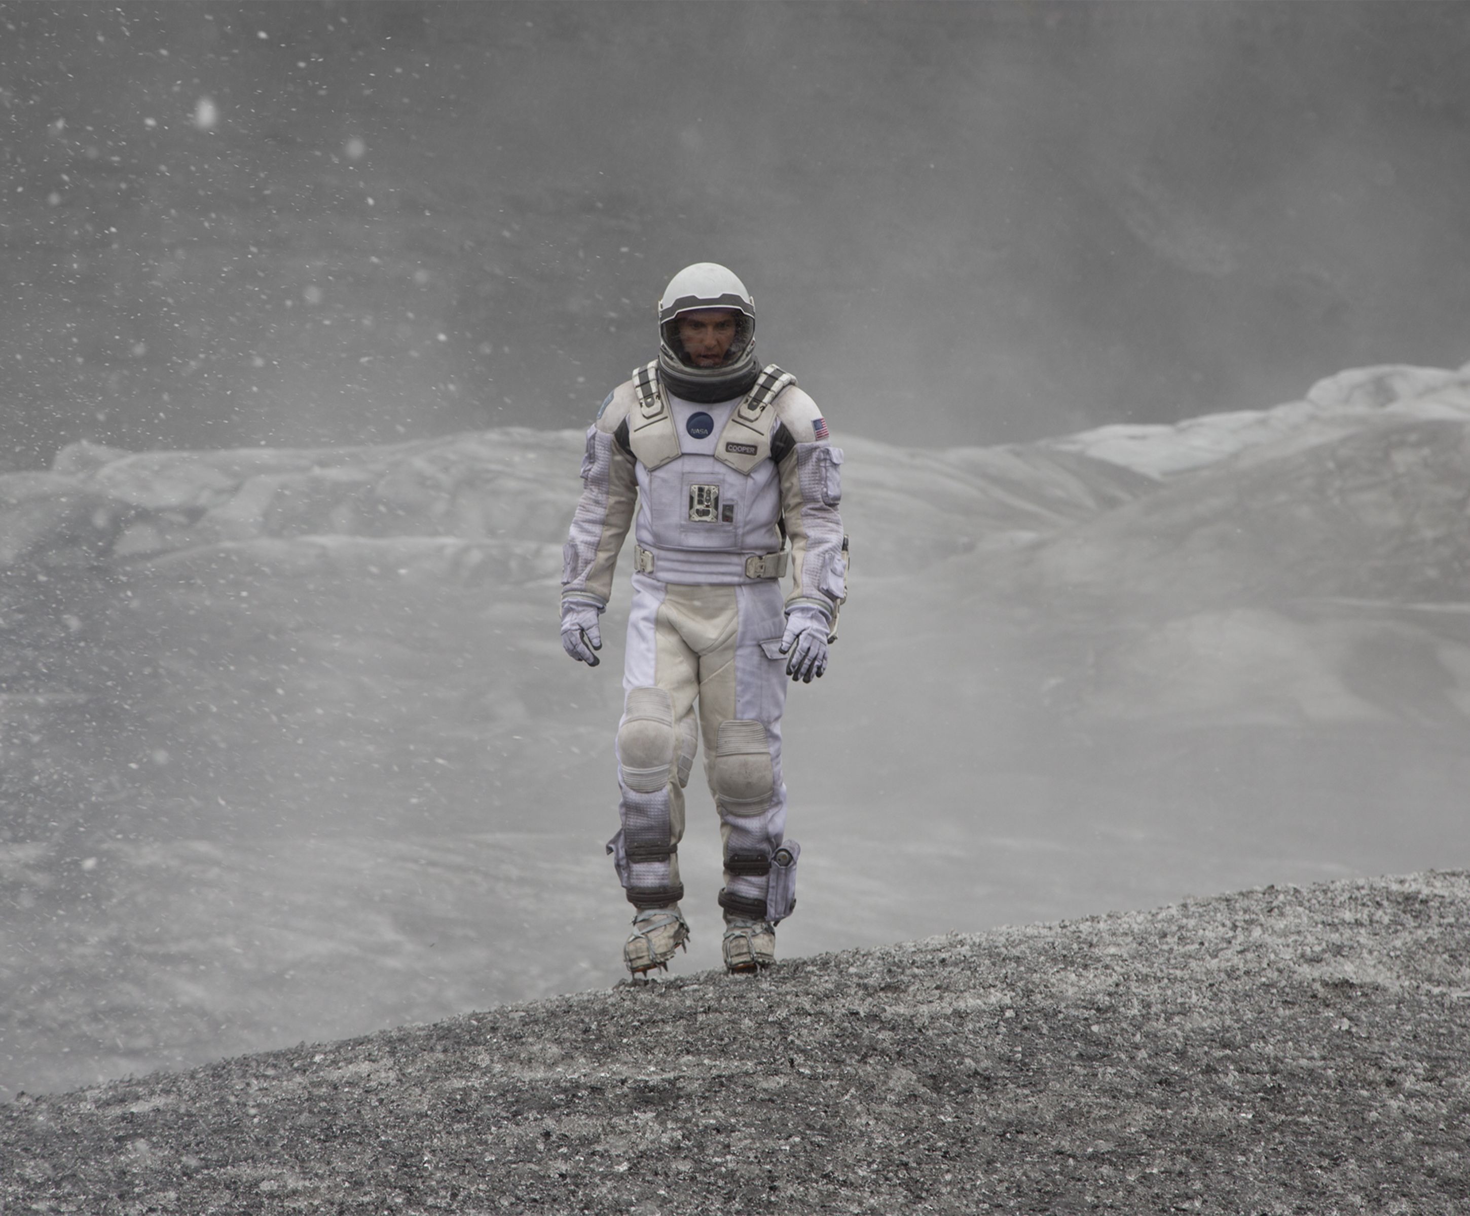
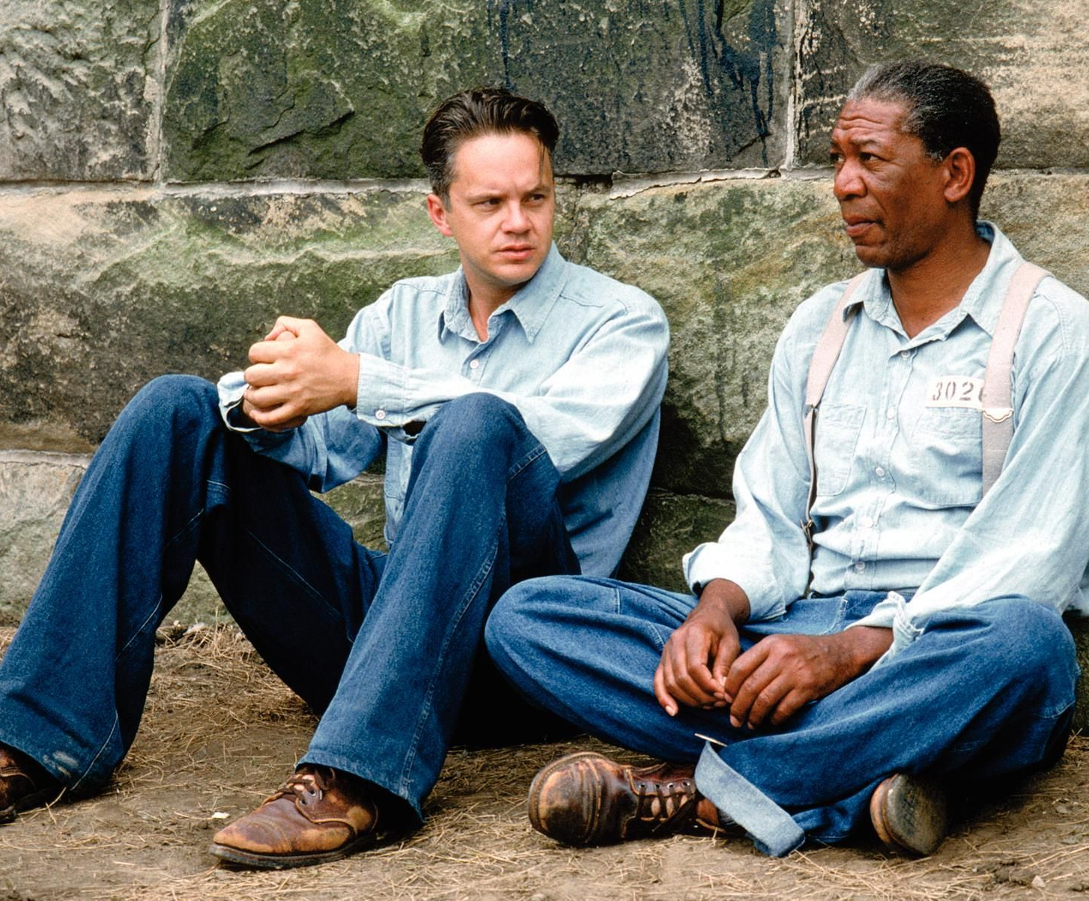
Agenda
Problem Statement
Proposed System/Solution
System Development Approach
Algorithm & Deployment
Result
Conclusion
Future Scope
References

Slide 3
Problem Statement
With the exponential growth of digital content, users are often overwhelmed by the vast array of choices available to them. In the realm of movies, this leads to difficulty in selecting films that match their personal preferences. Traditional recommendation systems often rely heavily on user-specific data and previously watched content, which may not always be available or sufficient, particularly for new users. There is a growing need for recommendation systems that can effectively suggest movies based on broader preferences, such as genre, to enhance user experience.

Slide 4
Proposed Solution
Data Loading and Preprocessing:
Load the movie dataset containing details such as title, genre, overview, popularity, release date, vote average, and vote count.
Feature Extraction:
Use the Term Frequency-Inverse Document Frequency (TF-IDF) vectorizer to transform the movie genres into numerical features. This step converts textual genre information into a matrix of TF-IDF features, which helps in quantifying the importance of each genre.
Similarity Calculation:
Compute the cosine similarity between all movies based on their TF-IDF feature vectors. This step measures how similar two movies are based on their genres.

Slide 5
Proposed Solution
Recommendation Algorithm:
Develop a function that takes a user-defined genre and the number of desired recommendations as input.
Filter the dataset to include only movies that match the specified genre.
Calculate the mean cosine similarity scores for each movie within the filtered genre to identify the most similar movies.
Sort these movies based on their similarity scores and return the top recommendations.
User Interaction:
Allow users to specify their preferred genre.
Generate and display a list of recommended movies, including their titles and genres, based on the user's input.

Slide 6
System Approach
Hardware requirement:
1.RAM– Atleast 8GB RAM
2.Intel i5 Core Processor
3.Hard Disk :Minimun 256 GB
Software Requirements:
Operating System : Windows (above 7 64-bit), Linux.
Programming Language: Python.
IDE(Integrated Development Environment): Google Colab or Jupyter Notebook or IBM Watson Studio.

Slide 7
System Approach
Libraries Used:
Pandas (`pd`):
Data Manipulation and Analysis: Pandas provides powerful data structures, such as DataFrames, which are essential for handling and manipulating structured data efficiently.
CSV File Handling: It offers easy-to-use functions like `read_csv` and `to_csv` to read from and write to CSV files, making it simple to load and save datasets.
Scikit-learn (`sklearn`):
TF-IDF Vectorization: The `TfidfVectorizer` from the `sklearn.feature_extraction.text` module converts text data into numerical features using the TF-IDF (Term Frequency-Inverse Document Frequency) method, which is crucial for text-based feature extraction.
Cosine Similarity Calculation: The `linear_kernel` function from the `sklearn.metrics.pairwise` module calculates the cosine similarity between vectors, allowing the algorithm to measure the similarity between movies based on their genre features.

Slide 8
Algorithm & Deployment
Data Loading and Preprocessing
Load Dataset: The dataset is loaded from a CSV file containing movie information, including genres.
Feature Extraction
TF-IDF Vectorization: The genres are transformed into numerical features using Term Frequency-Inverse Document Frequency (TF-IDF) vectorization. This step converts the text data (genres) into a TF-IDF matrix, which represents the importance of each genre in the dataset.
Similarity Calculation
Cosine Similarity: A cosine similarity matrix is computed using the TF-IDF matrix. This matrix contains similarity scores between all pairs of movies based on their genre features.
Recommendation Function
Filter by Genre: The function filters the dataset to include only movies that match the user's preferred genre.
Mean Similarity Scores: For the filtered movies, the mean cosine similarity scores are calculated to identify the most similar movies within the genre.
Sort and Select: The movies are sorted based on their similarity scores, and the top recommendations are selected.
Return Recommendations: The recommended movies are returned along with their titles and genres.

Slide 9
Algorithm & Deployment
Input Features:
Genres: The primary input feature used by the algorithm is the genre of the movies. The genres are processed using TF-IDF vectorization to create numerical representations for similarity calculation.
Data Utilization:
The dataset is used to extract the genre information of each movie.
The TF-IDF vectorizer transforms the genre information into a TF-IDF matrix, which is then used to compute cosine similarity scores between movies.
The cosine similarity matrix is utilized to determine the similarity between movies based on their genres.

Slide 10
Algorithm & Deployment
Prediction Process
Genre Input: The user provides a preferred genre (e.g., "Drama").
Filter Movies: The algorithm filters the dataset to find movies that contain the specified genre.
Similarity Calculation: For the filtered movies, the mean cosine similarity scores are calculated using the precomputed cosine similarity matrix.
Sort and Select: The movies are sorted based on their similarity scores, and the top similar movies are selected as recommendations.
Return Recommendations: The algorithm returns the recommended movies, including their titles and genres.

Slide 11
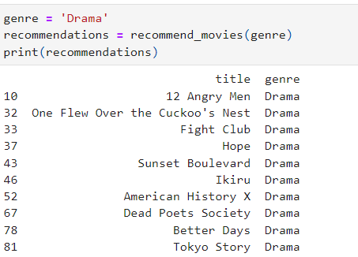
Result
Picture-1: List of 10 Movies of Genre “Drama”

Slide 12
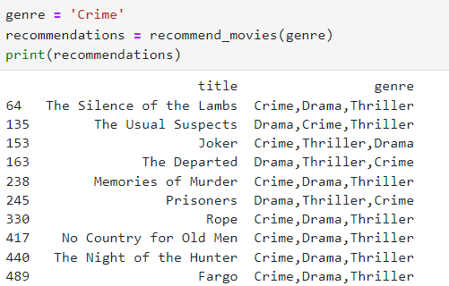
Result
Picture-3: List of 10 Movies of Genre “Crime”

Slide 13
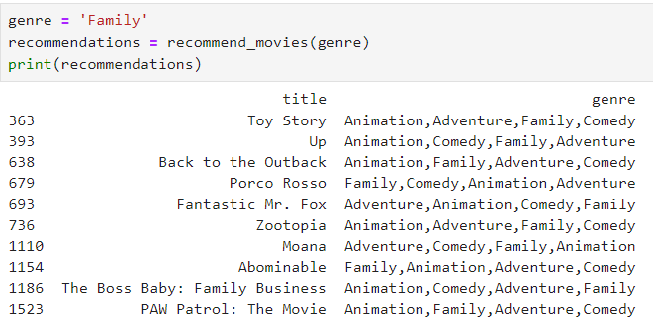
Result
Picture-2: List of 10 Movies of Genre “Family”

Slide 14
Conclusion
This genre-based movie recommendation system provides a robust solution to the problem of content overload by leveraging content-based filtering techniques. By focusing on user-defined genres, the system ensures relevant and personalized movie suggestions, improving user satisfaction and engagement.

Slide 15
Future scope
Incorporate Additional Features:
Integrate more features such as movie overviews, cast, directors, and user ratings to improve recommendation accuracy.
Real-Time Recommendations:
Implement real-time recommendation systems that update dynamically as new movies are added or user preferences change.

